Slide 1
HW1: IMAGE CLASSIFICATION WITH DISTRIBUTION SHIFT
Manuela Lo Giudice

Slide 2
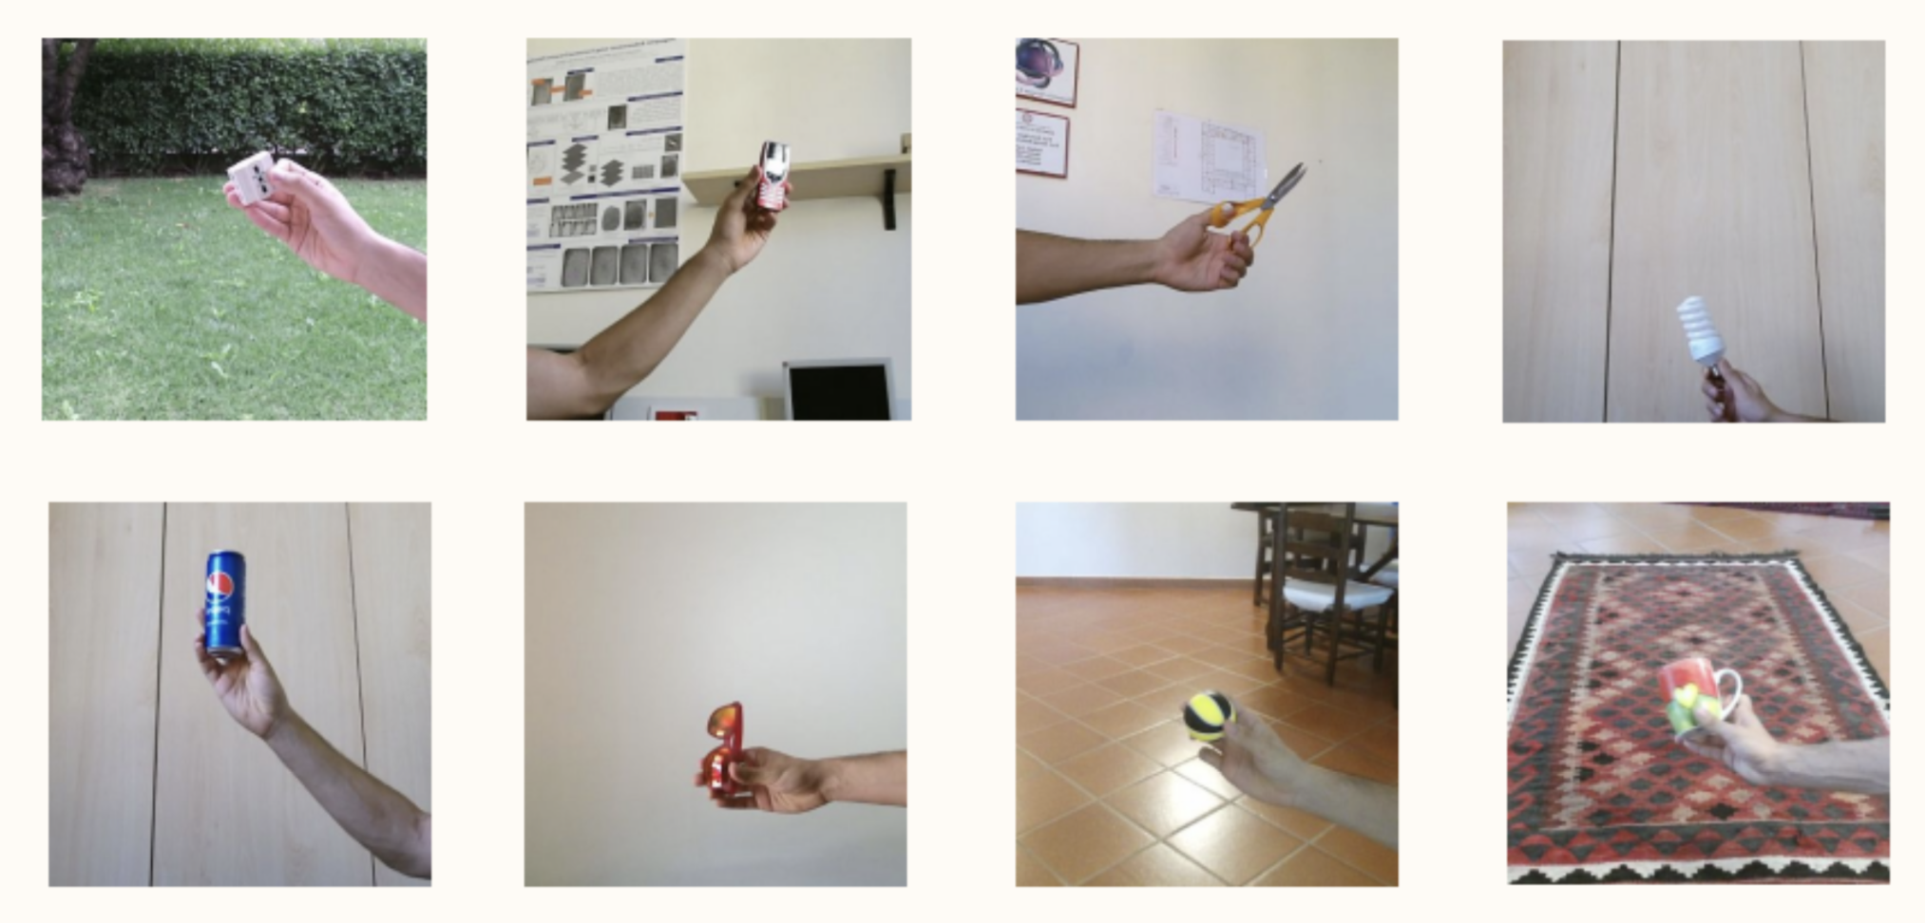
Description
This Homework is a Kaggle competition.
The dataset consists of images of handheld objects and exhibits a domain shift issue between the training and test data.
Dataset:
The training set contains 1600 images, with 200 images for each of the 8 classes.
The test set contains 800 images.
All the images have an original dimension of 350x350 pixels.
Bounding boxes available in a .csv file and provide information such as image id, coordinates (x1, y1, x2, y2), and class label.
The class 0 has the same background in all the test set images.
This results in a domain shift, indicating a change in the distribution of the data.

Slide 3
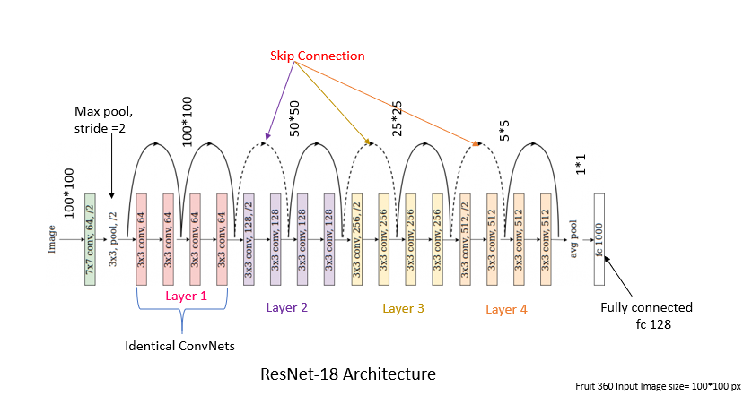
Model Architecture: Resnet-18
ResNet-18 is a specific variant of the ResNet (Residual Network) architecture, which was introduced by Microsoft Research in 2015. It is a convolutional neural network (CNN) model primarily used for computer vision tasks such as image classification, object detection, and segmentation.
ResNet-18 is known for its relatively compact architecture while still achieving high accuracy.
ResNet-18 architecture:
Input Layer
Entry flow
Residual Blocks
Global Average Pooling
Fully Connected Layer
Notes:
Understanding Feature Pyramid Networks for object detection (FPN) | by Jonathan Hui | Medium
FPN(feature pyramid networks). Getting free accuracy boost on almost… | by Sanchit Tanwar | Analytics Vidhya | Medium
Review: FPN — Feature Pyramid Network (Object Detection) | by Sik-Ho Tsang | Towards Data Science
Review: Faster R-CNN (Object Detection) | by Sik-Ho Tsang | Towards Data Science
Easiest RPN explaination, the core of Faster R-CNN. | by Kai | LSC PSD | Medium

Slide 4
Model Architecture: Resnet-18
Input Layer: takes an input image with three color channels (RGB) and a fixed size of 224x224 pixels.
Entry flow: The initial layer is a 7x7 convolutional layer with a stride of 2, followed by a 3x3 max pooling layer with a stride of 2. These layers reduce the spatial dimensions of the input image.
Notes:
Understanding Feature Pyramid Networks for object detection (FPN) | by Jonathan Hui | Medium
FPN(feature pyramid networks). Getting free accuracy boost on almost… | by Sanchit Tanwar | Analytics Vidhya | Medium
Review: FPN — Feature Pyramid Network (Object Detection) | by Sik-Ho Tsang | Towards Data Science
Review: Faster R-CNN (Object Detection) | by Sik-Ho Tsang | Towards Data Science
Easiest RPN explaination, the core of Faster R-CNN. | by Kai | LSC PSD | Medium

Slide 5
Model Architecture: Resnet-18
Residual Blocks: ResNet-18 consists of four sets of residual blocks, each containing multiple convolutional layers.
Each sets of block have the same structure:
Two residual blocks,
Each block has two 3x3 convolutional layers with padding,
followed by a skip connection that adds the input to the output of the block.
the convolutional layers use a stride of 1 and produce output channels.
Only the number of output channels changes.
The first has 64 output channels, the second has 128 output channels, the third has 256 output channel, the fourth has 512 output channels.
The skip connections in each residual block allow the network to learn residual mappings by capturing the difference between the input and output of a block. This facilitates the training of deep networks.
Notes:
Understanding Feature Pyramid Networks for object detection (FPN) | by Jonathan Hui | Medium
FPN(feature pyramid networks). Getting free accuracy boost on almost… | by Sanchit Tanwar | Analytics Vidhya | Medium
Review: FPN — Feature Pyramid Network (Object Detection) | by Sik-Ho Tsang | Towards Data Science
Review: Faster R-CNN (Object Detection) | by Sik-Ho Tsang | Towards Data Science
Easiest RPN explaination, the core of Faster R-CNN. | by Kai | LSC PSD | Medium

Slide 6
Model Architecture: Resnet-18
Global Average Pooling: It reduces the spatial dimensions of the feature maps to a fixed size, resulting in a 512-dimensional feature vector. Global average pooling computes the average value of each feature map across its spatial dimensions.
Fully Connected Layer: The 512-dimensional feature vector is fed into a fully connected layer with a softmax activation function. The number of neurons in this layer corresponds to the number of classes in the classification task, and it produces the final probability distribution over the classes.
Notes:
Understanding Feature Pyramid Networks for object detection (FPN) | by Jonathan Hui | Medium
FPN(feature pyramid networks). Getting free accuracy boost on almost… | by Sanchit Tanwar | Analytics Vidhya | Medium
Review: FPN — Feature Pyramid Network (Object Detection) | by Sik-Ho Tsang | Towards Data Science
Review: Faster R-CNN (Object Detection) | by Sik-Ho Tsang | Towards Data Science
Easiest RPN explaination, the core of Faster R-CNN. | by Kai | LSC PSD | Medium

Slide 7
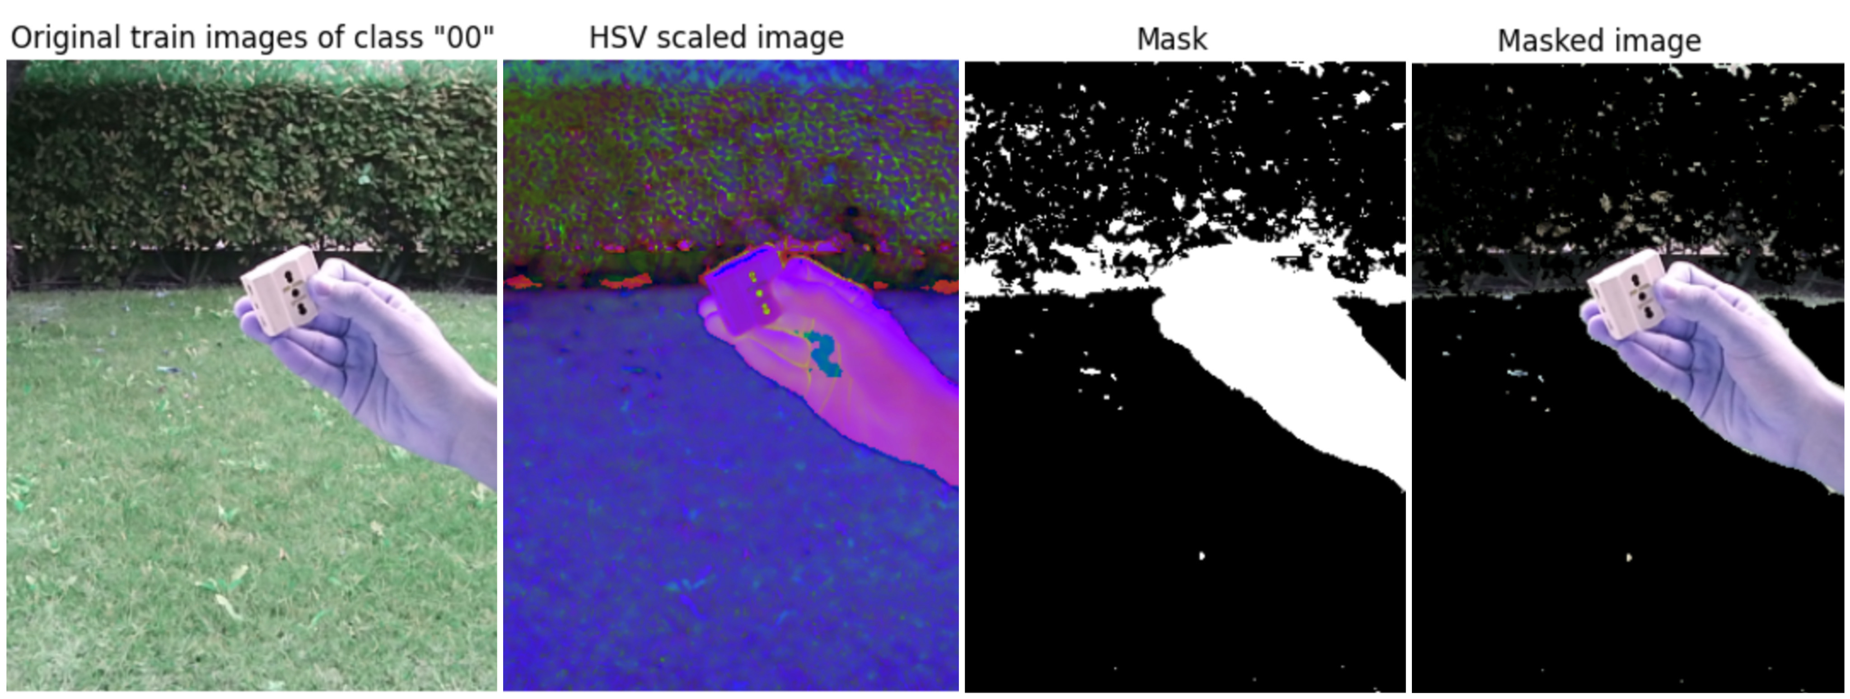
Image Segmentation - HSV scale
Method employed to mitigate the distribution discrepancy between class ”0” and the other classes.
Process is exclusively applied to images classified as belonging to class ”0”.
The initial step entails converting the images from the RGB color space to HSV, resulting in three-channel images where each channel represents a different aspect: Hue, Saturation, and Value.
The background was chosen by applying a threshold to the pixel values based on the range of Hue [36, 89], Saturation [25, 255], and Value [25, 255].
A binary mask was then created to exclude the selected background from the final image.
Notes:
Understanding Feature Pyramid Networks for object detection (FPN) | by Jonathan Hui | Medium
FPN(feature pyramid networks). Getting free accuracy boost on almost… | by Sanchit Tanwar | Analytics Vidhya | Medium
Review: FPN — Feature Pyramid Network (Object Detection) | by Sik-Ho Tsang | Towards Data Science
Review: Faster R-CNN (Object Detection) | by Sik-Ho Tsang | Towards Data Science
Easiest RPN explaination, the core of Faster R-CNN. | by Kai | LSC PSD | Medium

Slide 8
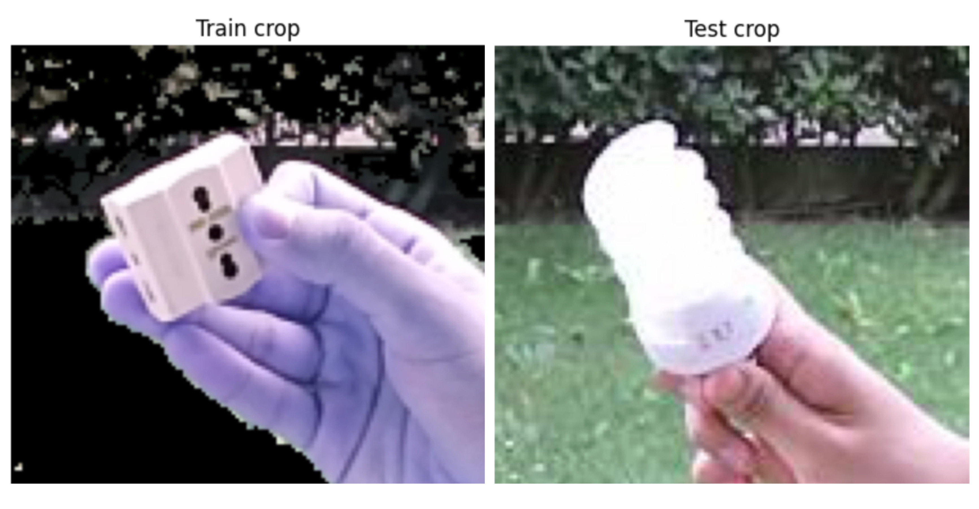
Image Crop
The process of cropping images based on bounding box allows the extraction of specific regions of interest and restrict the model’s focus to the specific area defined by the coordinates.
I took the directory of images, along with the CSV file containing the bounding box coordinates for each image, and croped the images accordingly.
The cropped images are then saved in a separate output.
I applied this method for both train and test data to improve ability to classify objects and model performance.
Notes:
Understanding Feature Pyramid Networks for object detection (FPN) | by Jonathan Hui | Medium
FPN(feature pyramid networks). Getting free accuracy boost on almost… | by Sanchit Tanwar | Analytics Vidhya | Medium
Review: FPN — Feature Pyramid Network (Object Detection) | by Sik-Ho Tsang | Towards Data Science
Review: Faster R-CNN (Object Detection) | by Sik-Ho Tsang | Towards Data Science
Easiest RPN explaination, the core of Faster R-CNN. | by Kai | LSC PSD | Medium

Slide 9
Training procedure - Data transformations
Train:
Resizes the image to a fixed size of 224x224 pixels.
Randomly flips with p=0.5.
GridDistorsion, with limit of distorsion between -0.2 and 0.2, p=0.3.
Randomly rotates 10 degrees.
Converts the image from PIL Image format to a PyTorch tensor.
Normalizes the input in the range ((0.485, 0.456, 0.406), (0.229, 0.224, 0.225)).
Test:
Resizes the image to a fixed size of 224x224 pixels.
Converts the image from PIL Image format to a PyTorch tensor.
Normalizes the input in the range ((0.485, 0.456, 0.406), (0.229, 0.224, 0.225)).

Slide 10
Training procedure - Data transformations
Resizes is a common practice to ensure consistent input dimensions for deep learning models,
Randomly flips is augmentation technique helps introduce variations and increase the robustness of the model during training,
Randomly rotates introduces further variations and helps the model learn to recognize objects from different angles,
Converts the image from PIL Image format to a PyTorch tensor it’s necessary for processing and feeding the image into a deep learning model,
Normalizes the image tensor by subtracting the mean values and dividing by the standard deviation values. This normalization step is crucial for improving the convergence and stability of the training process. The mean and standard deviation values provided ([0.485, 0.456, 0.406], [0.229, 0.224, 0.225]) are standard values often used with pre-trained models.

Slide 11
Hyperparameters
Optimizer
ADAM
Learning rate
0.003
Weight decay
0.0001
Adam optimizer: The optimizer is responsible for updating the model’s parameters during the training process.
Adam optimizer is a popular optimization algorithm known for its adaptive learning rate.
Adam assigns a specific learning rate to each parameter based on its past gradients and updates, not using a single global learning rate for all parameters.
The learning rate for the optimizer is set to 3e-4 (0.0003), which determines the rate for parameter updates.
It is used as initial learning and during the training progresses, the adaptive learning rates for individual parameters will be adjusted.
The weight decay parameter of 0.0001 is used to prevent overfitting.
CrossEntropyLoss: The loss function computes the discrepancy between the predicted outputs and the true labels, providing a measure of how well the model is performing.
Cross-entropy loss is commonly used for multi-class classification tasks.

Slide 12
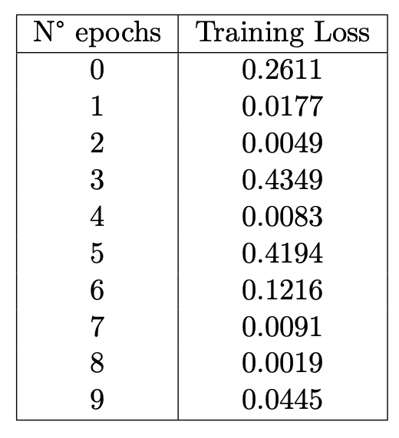
Experimental Results
The model has been trained for 10 epochs and these are the following training loss for each epoch computed:
The initial epoch started with a loss value of 0.2611, which decreased significantly to 0.0177 in the second epoch. As training continued, the loss consistently decreased, reaching a minimum of 0.0019 in the eighth epoch.
However, the third epoch exhibited an increase to 0.4349, while the fifth epoch showed a rise to 0.4194.
Possible factors contributing to these fluctuations include noise in the training data or an insufficient amount of data.

Slide 13
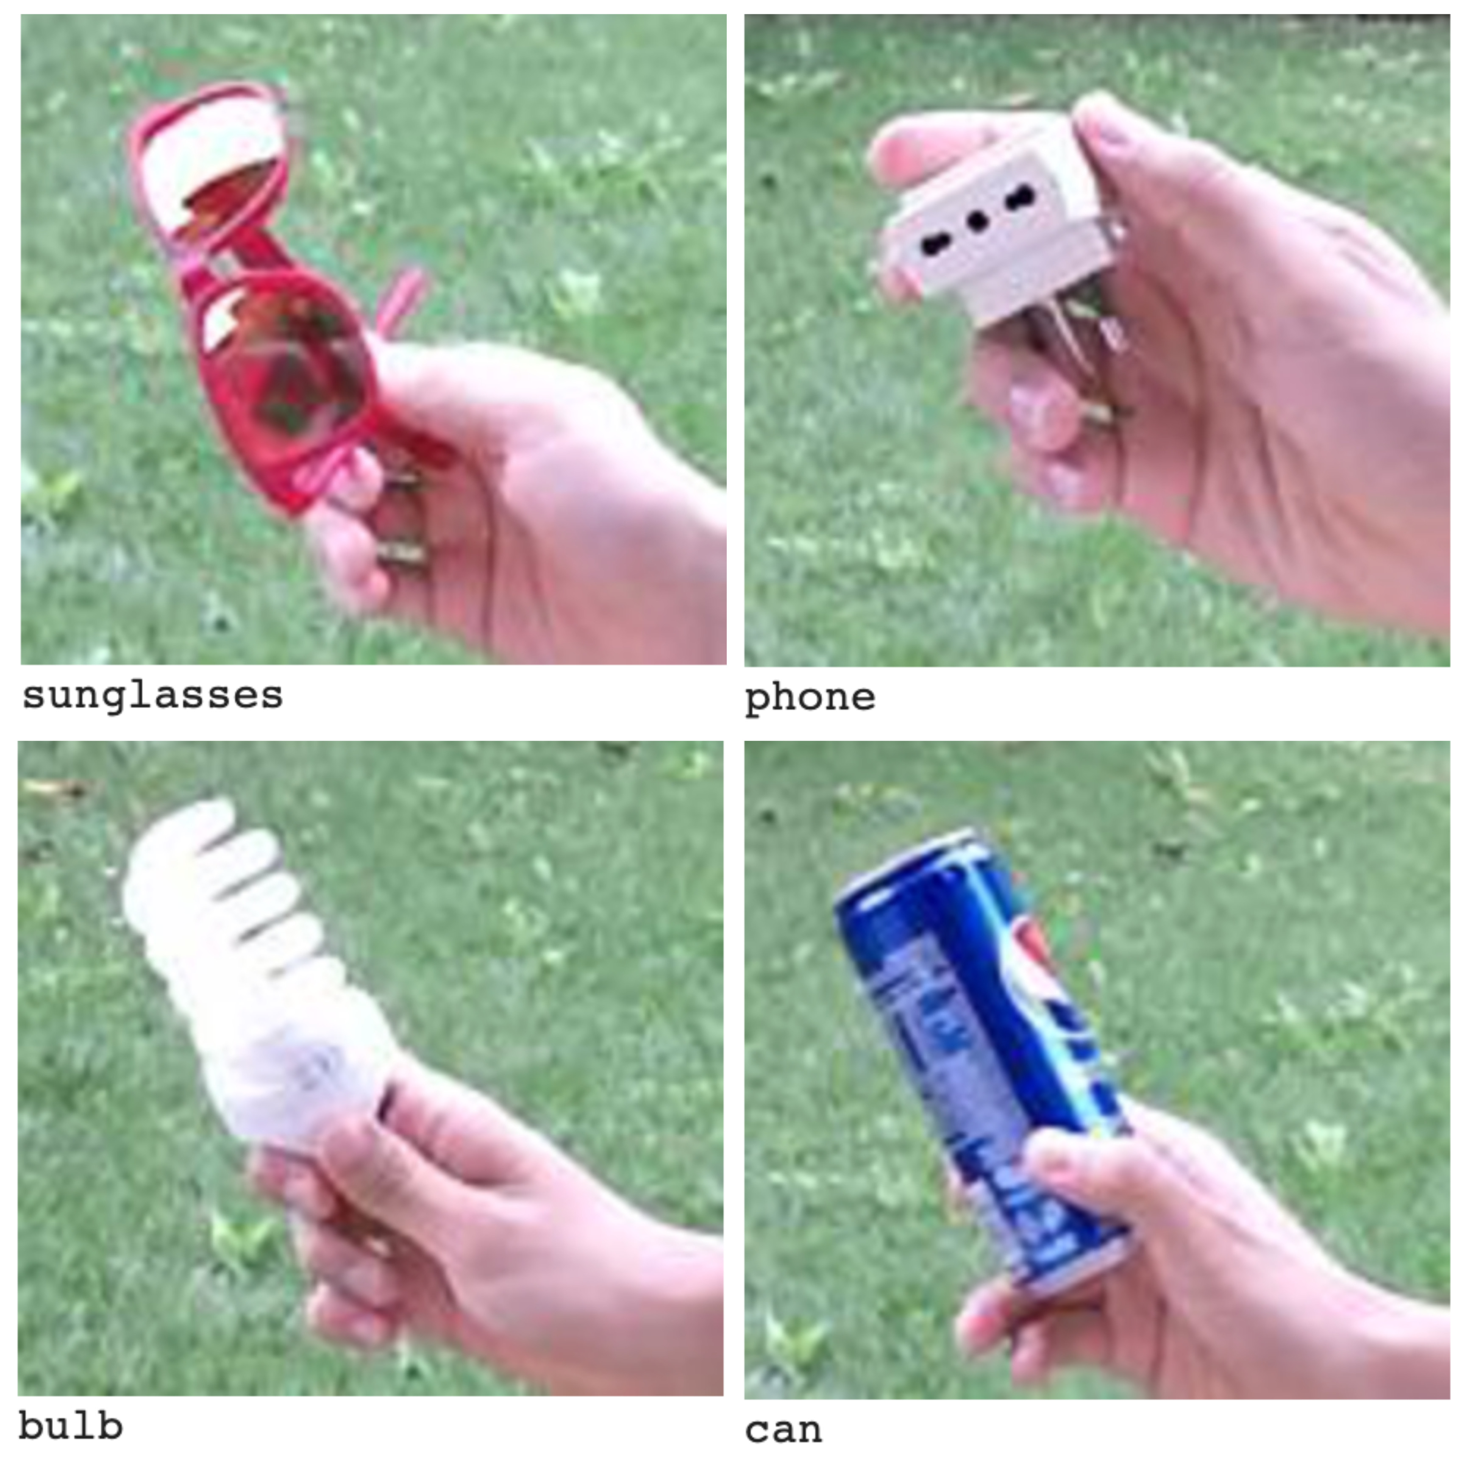
Experimental Results
Despite these fluctuations, the overall trend of decreasing training loss implies that:
the model gradually improved its performance over time,
learned from the training data,
adjusted its parameters to minimize the loss.
In the given example, the model demonstrated accurate recognition of the sunglasses, the light bulb, and the can.
However, it encountered difficulties in identifying the socket and mistakenly classified it as a phone.
In the end, I achieved an impressive accuracy of 89.5%.
Predicted bboxes

Slide 14
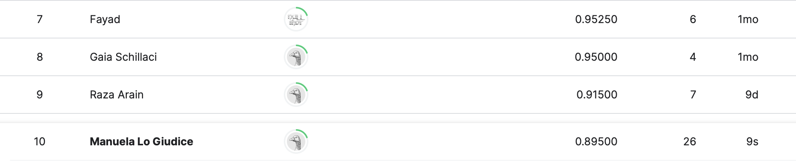

Results
Kaggle challenge results

Slide 15

Captum: Guided Grad-CAM
Captum is a Python library that allows us to understand the behavior and decisions made by the model.
One of the techniques supported by Captum is Guided Grad-CAM.
Grad-CAM stands for Gradient-weighted Class Activation Mapping.
It is a technique used for visualizing and understanding the important regions in an input image that contribute the most to the predictions made by a deep-learning model.
Grad-CAM generates a heat map that highlights the regions of the image that are important for the model’s decision.
In this case, it was able to generate and visualize attribution maps in the pre-trained ResNet-18 model.

Slide 16

HW2: Synthetic of Chest X-ray Images
Bita Davoodi - Manuela Lo Giudice

Slide 17
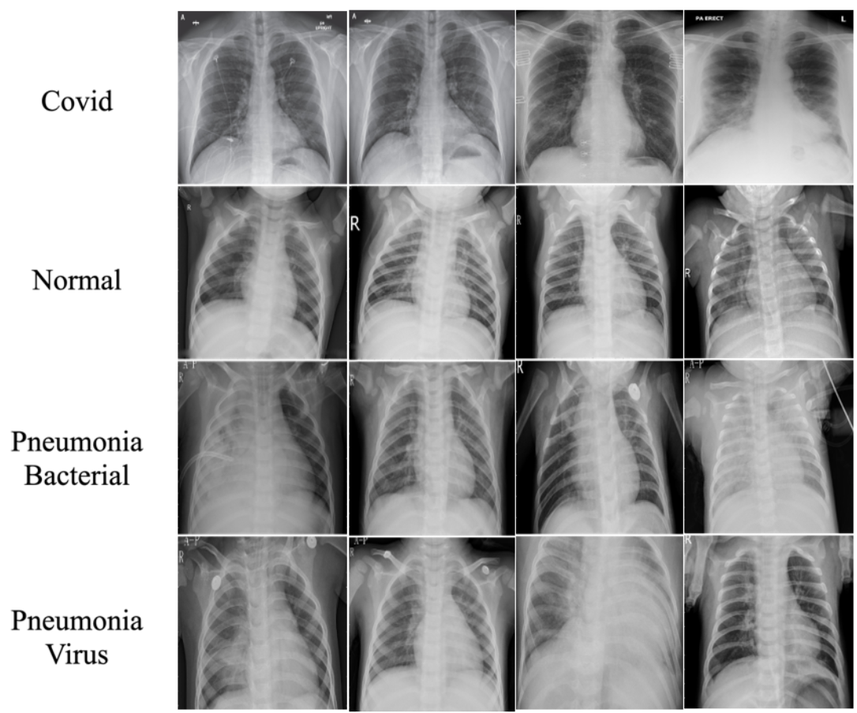
Generative Model: Dataset
The models are trained on the covid chest X-ray dataset which is found at the Github link https://github.com/ieee8023/covid-chestxray-dataset.
The dataset is well structured and contains 4 classes:
covid,
normal,
pneumonia bacteria,
pneumonia virus.
The dataset has a total of 270 training images (60, 70, 70, 70) and 36 test images (9, 9, 9, 9).
We used the default train/test split proposed by the creators of the dataset.

Slide 18
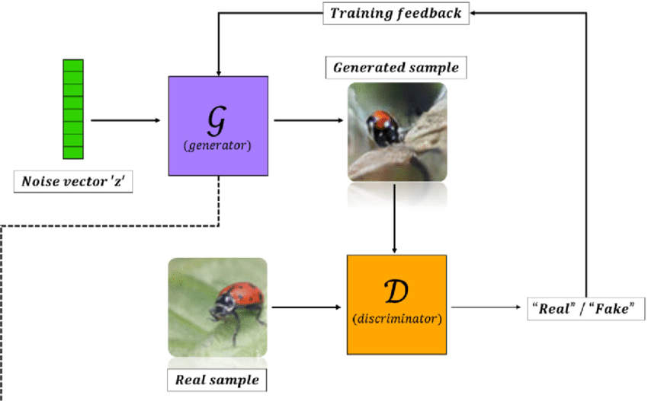
Deep Convolutional GAN (DCGAN)
DCGAN is a specific architecture of GANs that consists of a generator and a discriminator, both based on deep convolutional neural networks (CNNs).
Generator: The generator takes random noise as input and generates synthetic samples (fake images).
It transforms the noise through a series of transpose convolution layers to gradually upsample it into higher-resolution images.
Discriminator: The discriminator is a CNN-based classifier that receives images as input and distinguishes between real and fake samples.
It takes in both real images from the training dataset and the generated fake images from the generator.

Slide 19
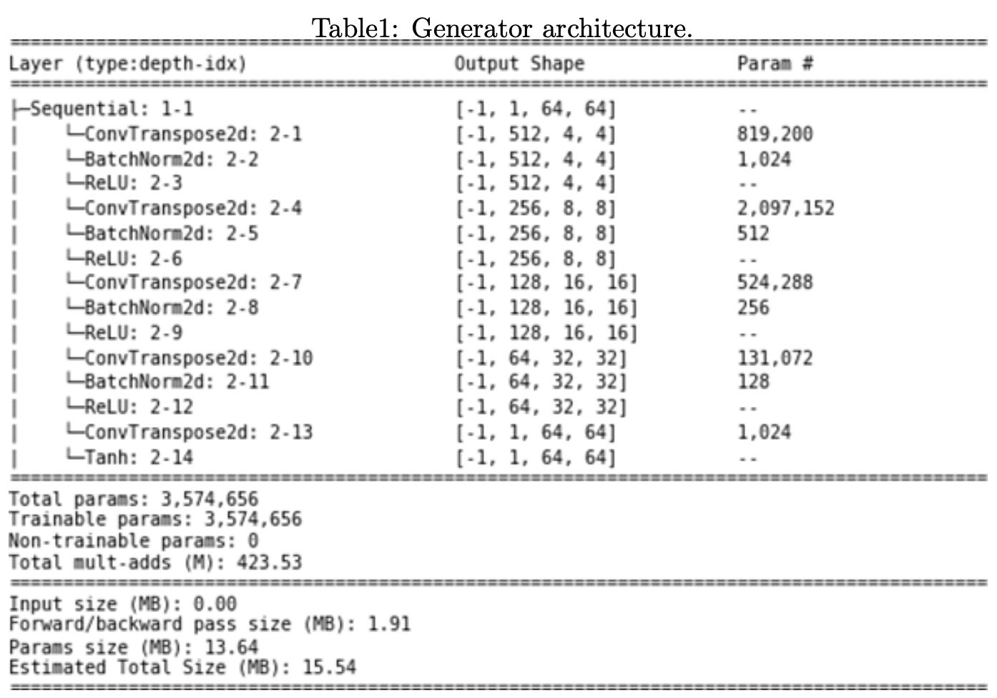
Generator Architecture
The generator network takes a vector of 100 random numbers that are latent noise used as input to generate realistic images.
Initial Layer:
The first layer is a transposed convolutional layer with latent noise vector as input channels and output channels 8 times the number of generator's feature maps.
The layer uses a kernel size of 4, a stride of 1, and no padding.
Batch normalization is applied to the output of this layer.
ReLU activation is applied to introduce non-linearity.

Slide 20
Generator Architecture
2. Upsampling Layers:
The subsequent layers gradually increase the spatial dimensions of the input tensors while reducing the number of channels.
Each upsampling layer is a transposed convolutional layer and the output of each layer is passed through batch normalization, and ReLU activation.
The number of channels is halved in each layer.
They have a kernel size of 4, a stride of 2, and a padding of 1.
3. Last Layer:
The last layer of the generator is a transposed convolutional layer with 64 x 32 x 32 as input channels and 1 x 64 x 64 output channels.
It uses a kernel size of 4, a stride of 2, and a padding of 1.
No batch normalization is applied after this layer.
The output of this layer is passed through a Tanh() activation function, which scales the values between -1 and 1.

Slide 21
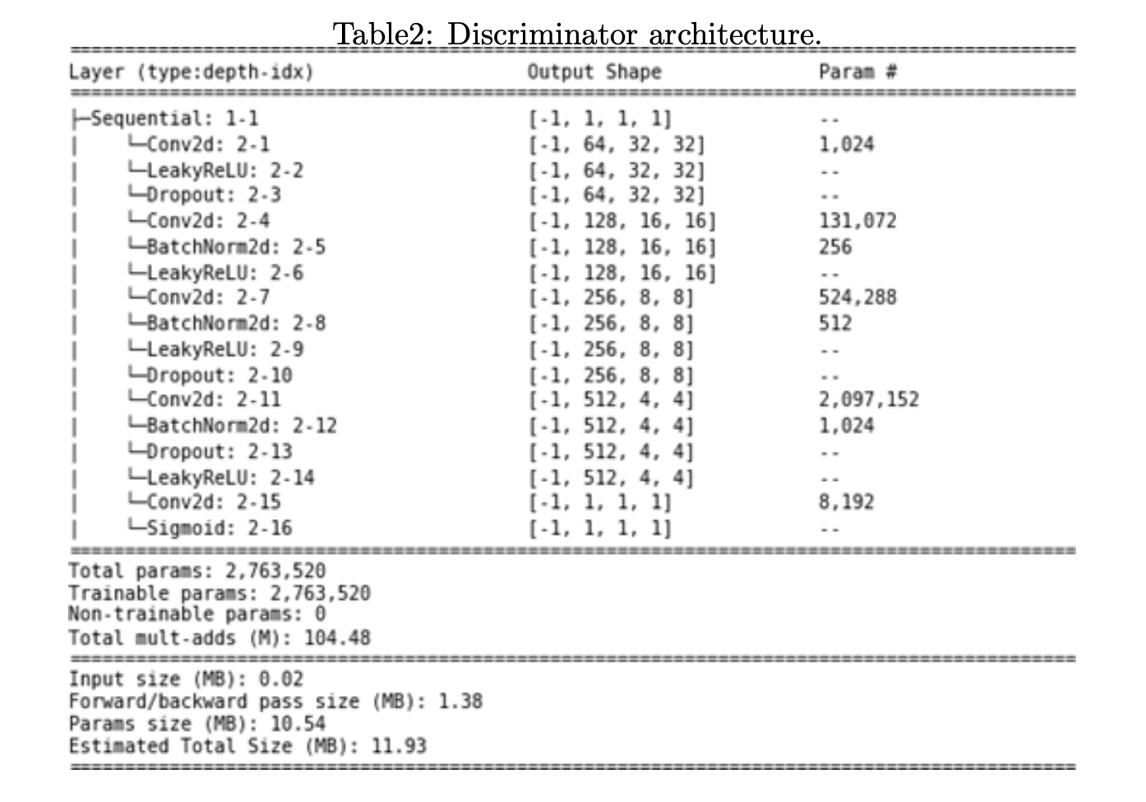
Discriminator Architecture
The discriminator network takes an input image tensor of size 1 x 64 x 64.
The final output is a scalar value between 0 and 1, indicating the probability of the input image being real (1) or synthetic/generated (0).
Initial Layer:
The first layer is a convolutional layer with input channels nc=1 and output channels ndf=64 (number of discriminator's feature maps).
Has kernel size of 4, a stride of 2, and a padding of 1.
LeakyReLU activation is applied to introduce non-linearity. It uses a negative slope of 0.2.

Slide 22
Discriminator Architecture
2. Downsample Layers:
The subsequent layers gradually decrease the spatial dimensions of the input tensors while increasing the number of channels.
Each downsample layer consists of a convolutional layer, batch normalization, LeakyReLU activation, and optional dropout.
The number of channels is doubled in each layer.
The convolutional layers use a kernel size of 4, a stride of 2, and a padding of 1.
Batch normalization is applied after each convolutional layer to improve training stability.
LeakyReLU activation with a negative slope of 0.2 is applied to introduce non-linearity.
Dropout is applied after specific layers to prevent overfitting during training. The dropout probability varies (0.5 or 0.25) in different layers.

Slide 23
Discriminator Architecture
3. Last Layer:
The last layer of the discriminator is a convolutional layer with ndf=64 * 8 input channels and 1 output channel.
It uses a kernel size of 4, a stride of 1, and no padding.
No batch normalization is applied after this layer.
The output of this layer is passed through a sigmoid activation function , which the output between 0 and 1, representing the probability that the input image is real or synthetic.

Slide 24
Training: GAN
Hyperparameters:
Four separate DCGANs were trained to synthesize images for each of the four classes of chest X-ray images.
The training process was done iteratively for the generator and the discriminator.
We used mini-batches of m = 32, both the discriminator and generator could train with stability.
The Leaky ReLU (Rectified Linear Unit), the slope of the leak was set to leak = 0.2.
Weights were initialized to a zero-centered normal distribution with a standard deviation of 0.02.
We applied stochastic gradient descent with the Adam optimizer,
an adaptive moment estimation that incorporates the first and second moments of the gradients, controlled by parameters β1 = 0.5 and β2 = 0.999, respectively.
A learning rate of 0.0002 was kept for both the generator and the discriminator.

Slide 25
Training: Classifier
Batch Size: We used operate in a small-batch regime because using a larger batch there is a significant degradation in the quality of the model, as measured by its ability to generalize.
Hyperparameters:
For training, we used a batch size of 256.
We used stochastic gradient descent optimization with a high learning rate (lr = 0.01), which performed very well for this specific task,
Nesterov momentum updates (m = 0.9), where instead of evaluating the gradient at the current position we evaluated it at the ”lookahead” position which improves the optimization and speed up the process.
Separates CNN were trained on different augmented chest X-ray scan types for each of the available datasets for variable epochs quantities depending on the dataset dimensions, between 150 epochs for small datasets to 300 epochs for larger ones.

Slide 26
Training: Evaluation Metrics - GAN
Epoch 200
In order to evaluate the performance of a GAN, we record the following training statistics:
Loss D: This represents the discriminator loss calculated as the sum of losses for all the real and all the fake batches.
Loss G: It is the generator loss calculated as the average output of the discriminator for all the real batches.
This should start close to 1 and then converge to 0.5 when G gets better.
D(G(z)): This is the average discriminator output for the all-fake batch. These numbers should start at 0 and converge to 0.5 as G gets better.
FID: Calculates Frechet inception distance (FID) which is used to assess the quality of generated images.
IS: Calculate the Inception Score (IS) which is used to assess how realistic generated images are.
Loss D: 1.2568
Loss G: 3.0651
D(x): 0.7847
D(G(z)): 0.5819 / 0.0646
FID: 1.1241
Inception
Score: 2.7996

Slide 27
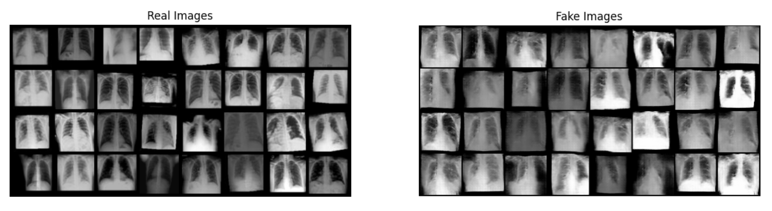
Training: Evaluation Metrics - GAN

Slide 28
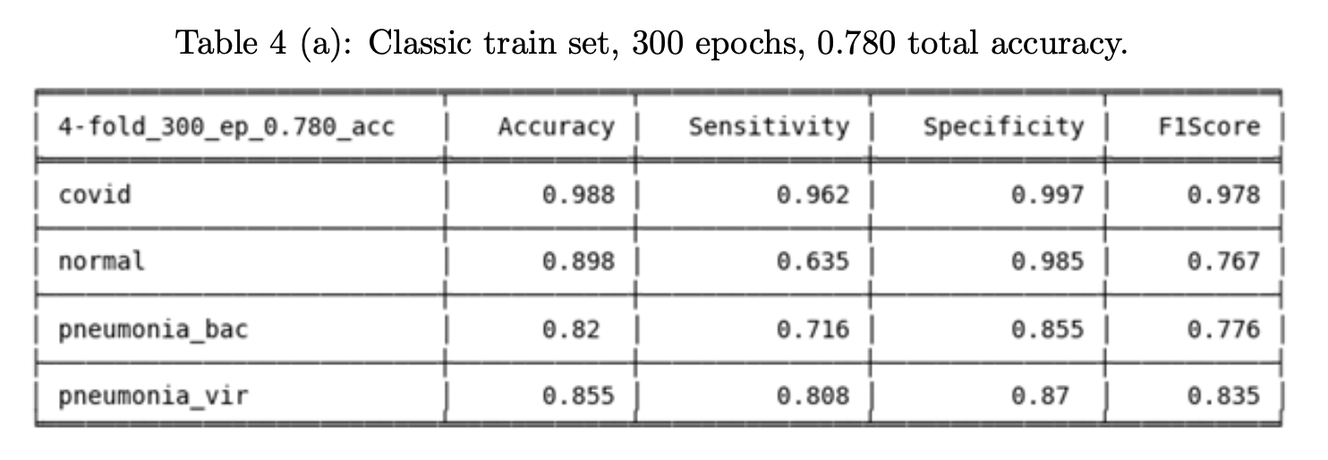
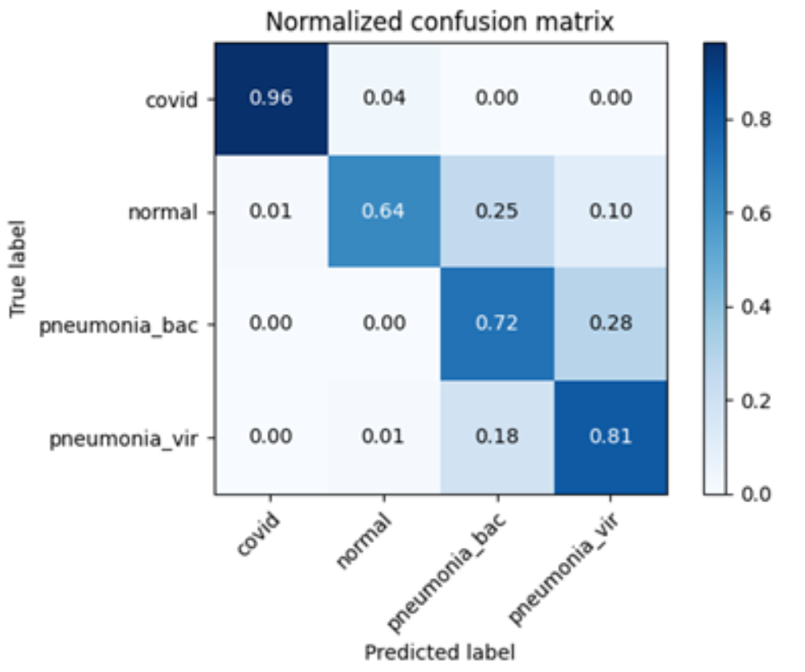
Training: Classifier
We calculated confusion matrices, sensitivity, specificity, accuracy, and F1 score measures for each lesion category in order to determine the classifier performance.
Results :
Accuracy: measure the overall correctness of the classifier's predictions.
Sensitivity: measures the proportion of actual positive instances that are correctly identified by the classifier.
Specificity: measures the proportion of actual negative instances that are correctly identified by the classifier.
F1 Score: is a harmonic mean of precision and recall (sensitivity). It combines the two measures and provides a single score that balances between them.

Slide 29
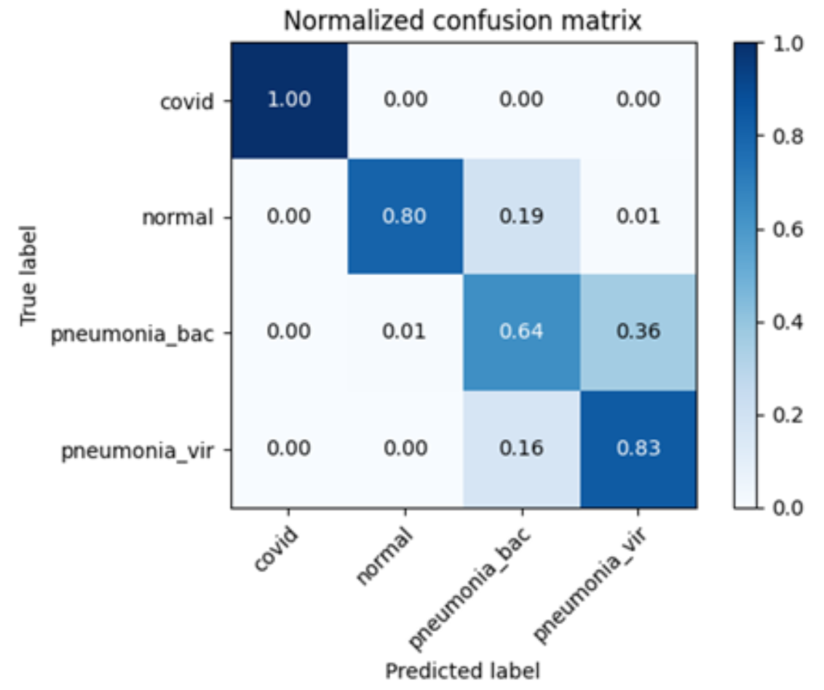
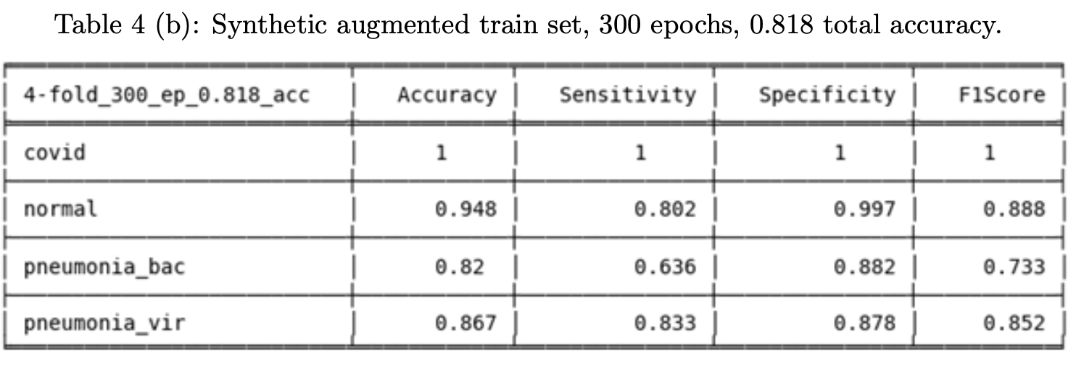
Training: Classifier
Results :

Slide 30
Conclusion
The number of images of the collected dataset was 270 images for four types of classes.
The classes are the covid, normal, pneumonia bacteria, and pneumonia virus.
The task of classification and detection of the four classes is quite challenging in the absence of a large dataset.
It was shown how the generated synthetic images could be used to increase the original dataset and eventually lead to a higher classification and detection accuracy of the chest X-ray images.

Slide 31

THE END

